Slide 1
CP4P * an xTLA Learning to Be a Programmer
* Computer Principles for Programmers
Notes:
So why college courses? For the same reason you went to school and learned how to read: we get together to help each other do difficult things. Our objective is to learn problem-solving skills, discover new ways to think, and to look at the world differently.
Although we are here to learn about technology, the teaching and learning itself is not about technology. Higher education is about discovery, exploration, creation, engagement and community; it is a social, collective and interactive process.
-------------------------------------------------------------------------------------------------------
1997 Think Different ad. https://youtu.be/vvmhFE5p0Z0
ICT is full of TLAs, three letter acronyms, like ICT (Information and Communications Technology).
ICT used to be a two-letter acronym (also a TLA): IT which came from IS (Information Systems) which came from DP (Data Processing).
https://en.wikipedia.org/wiki/Three-letter_acronym
Note that there are no FLAs, Four Letter Acronyms. There are only xTLAs, eXtended Three Letter Acronyms. (also, part of the joke)
-------------------------------------------------------------------------------------------------------
Possibly asked earlier in the course, "What technology is being referred to in this statement:
“It will create forgetfulness...because they will not use their memories?“
…come on, what have you heard your parents, grandparents, and grey-haired people (like me) say?
[the internet, smart phones, Wikipedia, etc]
It was Socrates in 370BCE who said, “Writing will create forgetfulness...because they will not use their memories.“ Ironically, Plato wrote it down for him in The Phaedrus.
Since then, every new form of technology has predicted doom. Gutenberg’s printing press caused quite a stir. People will no longer need to go to church or schools! They will stay home and read for themselves! But how will they understand and interpret what they read? (Seriously, this was the 15th century argument against the vernacular printing of the Bible and other classic works. No worries, so long as people don’t know how to read, we’re safe. See https://en.wikipedia.org/wiki/Johannes_Gutenberg)
The sky has been falling for a long time:
The 15th C vernacular Bible will replace the church and synagogue; society will surely fall apart. It wasn’t much different in mosques after the Qur’ān was mass produced.
Mass production of books will replace the madrasa, the university, and put monks and scribes out of the manuscript copying/reproducing business. Only the latter happened.
(Indeed, the printed word as new form of mass communication upset the cozy relationship between the "First Estate" of the Church and the "Second Estate“ being the Nobility. It simply didn’t do for the Third Estate – everyone else – to think for themselves. When that happened, the very much intended consequences of the Renaissance and Reformation resulted in a fair amount of upheaval in Europe priming the Enlightenment to foment revolutions. New tech (books >> mass education) created doom for the old ways. N.B. the Fourth Estate is an independent press and news media to keep the other estates honest. Sure, the press lies, and governments lie, but in a democracy, they are different lies.)
Sometime later, radio was going to replace the concert hall, and the classroom.
The telephone, and later the fax machine, would replace the office.
The cinema would replace live theatre.
Television was going to replace the cinema, and the classroom.
Computer based training would replace teachers, and the classroom.
The Internet would replace, well everything, with the first thing being governance. The idea of people engaging in unmonitored communications and self-organizing freaked-out authoritarian regimes, every one of which clamped down on the internet as they had for all other forms of mass communication. Plus ca change…
Common to all these cases is this: the advent of a new form of mass communication “challenged the entrenched monopolies of intellectual authority enjoyed by the learned class and threatened to upset the balance between that authority and the power of the state.” (https://www.encyclopedie-humanisme.com/?Arabic-printing)
Social media during the 2015 – 2020 Trump years in the United States did exactly this up to the point of instigating revolution on January 6, 2021. The difference between Trump populism and the French Revolution is that Trumpism depended on less education (more than half of USA adults lack functional literacy skills), and more on deliberate ignorance (of science, law, governance, and adoption of bizarre ideas and “explanations” from such as QAnon that flooded in to fill the vacuum created by the flouting of experts who had a clue) contrasted with the French Revolution which was aided by more education of people who read the philosophies of Descartes, Spinoza, Locke, Montesquieu, Voltaire, and Rousseau. In short, Trump’s discombobulation vs France’s Enlightenment.
Humans have complained about new technology changing things since the dawn of time.
Sure, that wheel thing you invented is a nice bit of tech, but a wheel is not much good without adding more tech like a cart. What are you going to do when the thing breaks a long way from home? You know those new things break all the time. How are you going to cross the deep stream – I can hold my bundle over my head…can you hold that cart over your head? And what about the soft marshy ground near the stream where the wheel will get stuck in the muck? No, you can't use the log we use to get over the river, it's too narrow for your cart. That wheel is not going to glide over rough ground, you're going to have to go round the things I just step over. Yeah, you can transport loads twice as heavy as mine, but you have to push an empty cart home. How is that cart load going to get up the hill? If you let go, the cart will roll away and crash at the bottom. Really? A donkey? You're gonna train a donkey to pull the cart? Now you've got to keep a donkey happy. Soon, you'll be expecting a vast infrastructure of roads and bridges, traffic laws, and satellite navigation to sort out the confusion. Pffft. Listen pal, you're just going to go round and round with that wheel thing.

Slide 2
Learning to Program
Programming is hard.
If it was easy, no one would pay us to do it.
Learning is hard.
If it was easy, it would be called doing.
So, learning to program is doubly hard.
We're going to feel wrong a lot through this process.
Notes:
There is discomfort in learning. It challenges our view of the world; it challenges our view of ourselves. If we don't learn, we stay the same. You came here to change, and that means learning how to feel and be wrong.
--------------------------------------------------
Getting curious and asking questions happens outside our bunkers of certainty. Sure, you can be certain about something but how will you know you are right about that thing you are so certain of?
N.B. Whatever you are not changing, you are choosing. Read that again.

Slide 3
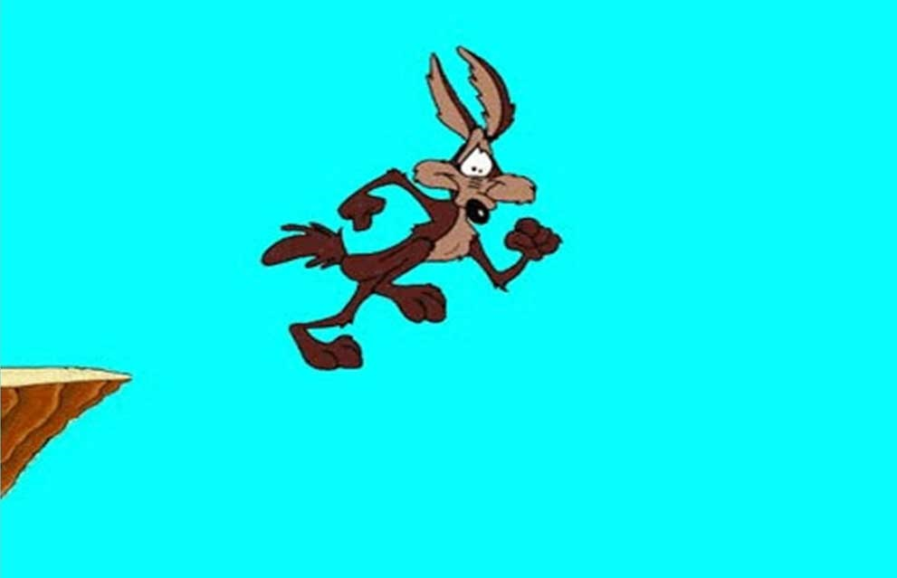
Programming: things to get used to
How does it feel to be wrong?
Being wrong feels like being right… until you realize you’re wrong, like Wile E. Coyote
The only real mistake is the one from which we learn nothing. – Henry Ford
Notes:
Tell me, what does it feel like to be wrong? Demoralizing, embarrassing, dreadful. Those are answers to a different question which is “What does it feel like to realize you are wrong?” Then it is “demoralizing, embarrassing, and dreadful.” [click] Wile E. Coyote can run and stand in mid-air so long as he thinks there is ground beneath his feet. It is only when he goes to feeling wrong that he falls. So, what does it feel like when you’re wrong? It feels like being right.
[ click ]
Learning in primary and secondary school has often meant getting the right answer and discovering that the way to succeed in life is not to make any mistakes. Sadly, when learning to program, we make a lot of mistakes. The editor corrects your typing. The compiler complains with cryptic error messages. Who has not thought, “This compiler must have a bug. There is nothing wrong with this code!” (Those who have not thought that have not thought it yet.) Then the program crashes or loops infinitely. The test case fails. Things seem wrong until they are right…and then you’re done. On to the next project where we will feel wrong again for 99% of the time.
The opposite of being wrong is not being right. Scientists know they are never right; rather, they have not yet proved themselves wrong. The opposite of being wrong is certainty. The opposite of certainty isn’t uncertainty. It is openness and curiosity. If you are open and curious, you can’t be wrong.
—————————
We know human nature is fallible. But we don’t like the experience personally.
Even when we know we are right and not wrong, we may still doubt ourselves; it is called imposter syndrome. "You still question your ability and you’re waiting to be exposed. More formally, it’s often referred to as “a failure to internalize success.” You attribute your accomplishments to luck or insane amounts of effort, but never talent or skill." – see https://www.bakadesuyo.com/2020/01/overcome-impostor-syndrome/ “Fear changes our perspective more than we realize. Fear basically forces us to not think. We humans usually have assumptions about everything, so the fear usually forces us to believe in those assumptions without much thinking. The solution which I found is to have the courage to accept even the worst of things which could happen.”
[This is] “negative visualization,” a practice that originated with the Stoics. The idea of negative visualization is to vividly imagine the worst-case scenario and challenge yourself to mentally prepare for it and become comfortable with it. This comfort will then eliminate or at least drastically reduce the emotional reaction to many of your fears. https://markmanson.net/life-lessons-from-2020?utm_source=nextdraft&utm_medium=email)
"You can't go wrong being wrong." "Errors are how our assumptions become visible. And there is little more valuable than a newly-discovered assumption, because only then can you see what's holding you back and what could propel you forward." see http://www.hyperorg.com/backissues/joho-apr30-99.html#wrong
"An expert is a man who has made all the mistakes which can be made in a very narrow field." – Niels Bohr, quantum physicist, Nobel Prize in Physics in 1922
Good judgement comes from experience, and experience comes from bad judgement. – Frederick P. Brooks Jr., "The Mythical Man-Month: Essays on Software Engineering" 1975 and 1995 20th Anniv. Ed.
https://www.goodreads.com/author/quotes/3174788.Frederick_P_Brooks_Jr_
"The only way to be truly confident is to simply become comfortable with what you lack." – Mark Manson "Comfort in our failures allows us to act without fear, to engage without judgment, to love without conditions." https://markmanson.net/how-to-be-confident
You know that friend who regales you with their long tale of woe. This happened, and IF only…, then that would not have happened. After a long tale of sequential and conditional events, they subject you to the third form of programming logic: iteration. They repeat the same story over and over trying to understand their problem. And you want to say, "Stop! Give yourself a break."
How many times have we struggled into the wee hours of the morning—just one more compile? YOU are that friend in the middle of the night who will not stop and give themselves a break. After we finally do stop and get some sleep, we often realize the answer to the problem while having a shower the next morning, that is, after we let go of what we thought was right, after we let go of our certainties.
Think about all the mistakes you have made in life… …and as an apology for making you think of that, remember how many of those mistakes were useful in some way – probably most of them. From learning how not to make that mistake again to the insight that created many of the world's greatest inventions, mistakes can be a good thing to get used to. There will always be a few mistakes we regret having made in life but worse is regretting the things we did not do because we were afraid of making a mistake.
“Being wrong is not some kind of embarrassing defect in the human system, it's fundamental to who we are; it is the source and root of all of our productivity and creativity.” (Karen Schultz, 2010)
"failure is the essence of programming" – Chris Szalwinski, faculty in SDDS, Seneca College,
* Frederick P. Brooks Jr., "The Mythical Man-Month: Essays on Software Engineering" 1975 and 1995 20th Anniv. Ed.
https://www.goodreads.com/author/quotes/3174788.Frederick_P_Brooks_Jr_

Slide 4
Small Problems Quiz: (click once to start slide timer) 3 questions, 20 seconds each to note the answer.
A bat and a ball cost $1.10 in total. The bat costs $1.00 more than the ball. How much does the ball cost?
If it takes 5 machines 5 minutes to make 5 widgets, how long would it take 100 machines to make 100 widgets?
In a lake, there is a patch of lily pads. Every day, the patch doubles in size. If it takes 48 days for the patch to cover the entire lake, how long would it take for the patch to cover half of the lake?
Notes:
Let’s try a little thinking quiz…
KEEP ANSWERS TO YOURSELF DURING THE QUIZ, we will all review afterward.
ready? [click only once to start. Animation timing will take care of the rest] [debrief following the quiz…]
1st 1.10 minus the 1.00 more = .10 for (the ball and the bat) / 2 = 0.5 Ball 0.05 + Bat 1.05 (a dollar more) = $1.10 total
An easier question to get right is "A banana and a bagel cost 37 cents. The banana costs 13 cents more than
the bagel. How much does the bagel cost?" nothing intuitive comes to mind, the banana and bagel are unrelated things so can be considered abstract items; algebra is needed. 37 – 13 = 24 / 2 = 12. 12 + (12+13) = 37
2nd How long does it take one machine to make a widget? five minutes . It takes 5 minutes for any number of machines to make one widget each.
3rd 48 days is not an even number of weeks or fractions of a month – 48 becomes just a number and not a measure of time, 48 is a number trivially easy to divide by two, 24 is 'half' 48, 48 is 'double' 24.
Don’t feel bad if your score was not perfect. Zero is not unusual. over 3,428 respondents in 35 separate studies averaged 1.24; a thousand people were from some of the top universities in the USA including MIT.
Massachusetts Institute of Technology students were the highest scoring group with average of 2.18 and just less than half of them got a perfect score.
This is the Cognitive Reflection Test developed by Shane Frederick (2005). The Cognitive Reflection Test (CRT) is one of the most widely used tools to assess individual differences in intuitive–analytic cognitive styles. Each question cues a highly available and superficially appropriate but incorrect response, conventionally deemed the intuitive response. To do well on the CRT, participants must reflect on and question the intuitive responses, then override that with slower, reflective, deductive analytical reasoning. The test is not strongly correlated with IQ, however, on the CRT together with other cognitive measures, it was found that "being smart makes women patient and makes men take more risks.“ Please be advised.
https://en.wikipedia.org/wiki/Cognitive_reflection_test
http://www.sjdm.org/dmidi/Cognitive_Reflection_Test.html
https://en.wikipedia.org/wiki/Cognitive_miser

Slide 5
Richard Feynman:
The first principle is that you must not fool yourself,
and you are the easiest person to fool.
Notes:
In classes and labs and assignments, we rightfully start with intuitive / inductive reasoning. We reflect on our experience and look for patterns matching what we already know. We must notice when our inductive reasoning says, “Relax, I’ve got this. It looks right" and deliberately switch ourselves to effortful, deductive reasoning. Because we feel like we're right until we know that we're wrong.
Humans rely on intuitive reasoning when making decisions every day. It’s quick, ‘feels’ right and is right most of the time. Finish this sentence, “The giraffe had a very long ____.”
"neck" comes from inductive reasoning. It is the most salient and differentiating characteristic of the giraffe; without context, "neck" is the most likely way to end that sentence. Maybe the giraffe had a very long...flight from Kenya?
Inductive reasoning is based on observation and experience. Even if we've never met a giraffe, we feel qualified to end that sentence with "neck". Inductive reasoning is fast, generally effective, and satisfied with good enough. It is how we learned language as young children (and why children overgeneralize rules of language until they learn the exceptions). Intuition is what we use to get through the day. Our experience tells us we are probabilistically right, we are close enough. The ball cost 10 cents.
———————————————-
The human brain is a statistical analyzer. After thousands of repetitions of slightly disparate stimuli, it begins to map for commonalities. “practice makes permanent” That allows the brain to develop anticipatory response patterns, or a set of common reactions, which minimize effort and increase speed and efficiency.
Richard Feynman: a revered teacher, researcher, physicist, Nobel laureate, and a mensch.
search?q=Richard+Feynman
.

Slide 6
How do you think like a programmer?
Start with inductive reasoning
Our minds are efficient before they are analytical.
Be aware of biases.
Humans are 'cognitive misers'
End with deductive reasoning
Spend some cognitive energy.
Verify assumptions when debugging.
Test to prove you are wrong. Try to break your code.
Notes:
[on blank screen…] Two robots walk into a bar. . . One robot orders 1.0146 root beers. The bartender says, "that’s a root beer float." The other robot says, "better make it a double." Humour needs 'real world' experience and inductive reasoning to be funny. Robots and AI will never laugh convincingly.
After all the cautions about inductive thinking, you can’t avoid it and you need it to get started.
Programming bridges the gap between concepts in one’s head (often someone else’s head) and the abstraction of those concepts into code.
[click]
The act of programming implements human ideas originating from inductive, intuitive, quick reasoning. But there is a price for speed and easy thinking: inaccuracy. We must be aware that we have biases and that humans are cognitive misers. (Even the world’s expert on this admits he has great difficulty overcoming these things.)
Programming requires deductive reasoning which is slow, laborious, and requires reflection with analysis. Be aware of the traps of inductive reasoning.
Where do you start when debugging? You start where your inductive reasoning guesses the problem exists. But surely, you’ve learned that is not always the case. So, check that the other code is as perfect as you assume it be. Check that variables have the values you believe they hold.
When testing, we like to make ourselves feel like we’ve done a good job. We construct input test data to get the expected output. But you cannot “prove the null hypothesis”, you can only fail to disprove it. Be a scientist, try to prove you are not a brilliant programmer. If you are unsuccessful at this, you can accept, for the time being, that you are as brilliant as you hypothesize.
“People do not deploy the powerful human intellect to dispassionately analyze the world,” William J. Bernstein writes, in 'The Delusions of Crowds.' Instead, they “rationalize how the facts conform to their emotionally derived preconceptions."
——————-
BTW, you know what happens when you assume, it makes an ASS of U and ME.
See https://www.theglobeandmail.com/business/technology/article-stop-me-if-youve-heard-this-one-r2-d2-walks-into-a-bar-and/
https://en.wikipedia.org/wiki/Cognitive_miser
Heuristics are the "judgmental shortcuts that generally get us where we need to go—and quickly—but at the cost of occasionally sending us off course." Inductive reasoning fits that definition. Much of the cognitive miser theory is built upon the analysis of heuristics in judgment and decision-making, most notably done by Amos Tversky and Daniel Kahneman who won a Nobel Prize in Economics for their work. Kahneman and Tversky demonstrated that people rely upon different types of heuristics or mental short cuts in order to save time and mental energy.

Slide 7
Charles Bukowski
The problem with the world is that the intelligent people are full of doubts,
while the stupid ones are full of confidence.
Notes:
Only wise people say, "I don't know."
It is okay to be unsure. We are all working with imperfect and incomplete information. It is why programmers do analysis and design before they take action writing code.
“there are three kinds of people in the world:
those who don't know and don't know they don't know;
those who don't know and do know they don't know; and
those who know and know how much they still don't know.”
― Karen Marie Moning, Bloodfever
You're Really Not That Smart: The Dunning-Kruger Effect | Psychology Today https://www.psychologytoday.com/us/blog/here-there-and-everywhere/201910/youre-really-not-smart-the-dunning-kruger-effect
Courage is knowing it might hurt, and doing it anyway.
Stupidity is the same.
And that's why life is hard. ― Jeremy Goldberg
When you are dead, you do not know you are dead. It's only painful & difficult for others. The same applies when you are stupid.
― Philippe Geluck
“what matters most is how well you walk through the fire” ― Charles Bukowski
“Human beings, who are almost unique in having the ability to learn from the experience of others, are also remarkable for their apparent disinclination to do so.” — Douglas Adams
“There is a theory which states that if ever anyone discovers exactly what the Universe is for and why it is here, it will instantly disappear and be replaced by something even more bizarre and inexplicable. There is another theory which states that this has already happened.” ― Douglas Adams

Slide 8
Thinking like a programmer
Decide to be hopeful, optimistic, adopt a growth mindset.
Reveal inductive reasoning, encourage deductive reasoning.
"Why do I think this should work?" instead of "What's wrong?"
Never assume. It makes an ass of u and me.
Experiment. Encourage Error. Failure –> Learning
You can't go wrong feeling wrong. "Fail Fast"
feeling wrong is a programmer's default state but not a permanent state.
/* no comment */ Write the comments first.
Comments get from inductive to deductive reasoning.
Notes:
A fixed mindset attributes failure to inability: you are not smart enough, not talented enough. If you see intelligence and inherent ability as immutable fixed traits, you'll never get better enough to overcome the failure.
Failure starts as a bruise; the fixed mindset turns it into a tattoo reminding you, if the challenge comes up again, to save time and just give up.
BTW, intelligence and ability are not fixed traits, they can be developed but only with a growth mindset. Know-it-all is a fixed mindset. Learn it all is a growth mindset.
Being hopeful, optimistic, and working with a growth mindset is a decision to give up old beliefs. Beliefs are not facts. You can choose to believe something different. There is solid psych research on this. Belief can be destiny.
[ click ]
Reveal inductive reasoning by asking yourself, "Why do I think this should be working?" instead of "What's wrong with this code that I cannot see?" The first question will reveal assumptions. And you know about assuming.
[ click ]
How did you learn to ride a bicycle? …most people say, "by falling off". That was learning how NOT to ride a bicycle. You learned to ride a bicycle by getting back on. But why did you get back on? When you looked around, everyone else was riding bicycles, even that clumsy kid from down the street. But you weren’t. The skinned knees, hands, and elbows were obvious proof you could not do it. However, everyone assured you that it was normal not knowing how, that no one “gets it” right away, that is it not an inborn talent. But it was possible, and it will happen, and happen sooner than you think. How long did it take for you to learn? Months? No. Weeks? More likely, days to become good at it, hours or less to not fall off. Although there are teaching techniques, you were not literally taught how to ride a bicycle – only you can teach your inner ear and your brain to work together so you can stop falling off. More than anything, you were taught to believe in the possibility that you could use different strategies and learn how to ride – that is a growth mindset: to give up the certainty of being wrong.
[ click ]
Writing the comments first reduces the anxiety of getting to the solution. It forces deductive reasoning. How many times have you been puzzling about something, started asking someone a question, and by the time you reach the question mark, you said, "Never mind, I got it." Putting thoughts into an intelligible question forces the deductive reasoning process that results in answering your own question.
Comments are a necessary practice of professional coders. "Always code as if the guy who ends up maintaining your code will be a violent psychopath who knows where you live." — John Woods
Write comments to avoid psychopathic mayhem.
https://www.bicycling.com/skills-tips/a20026575/how-to-learn-to-ride-a-bike-as-an-adult/
"If we knew what it was we were doing, it wouldn't be called research, would it?" attributed to Albert Einstein. The Dilbert creator, Scott Adams, says his Secret of Success was Failure. https://www.wsj.com/articles/scott-adams8217-secret-of-success-failure-1381639163 SCOTT ADAMS SAYS Two Wrongs Don’t Make a Right, You need way more wrongs than two.
———————————————————–
How to keep up your growth mindset, your hope and optimism? Have a system, a process, a disciplined approach that, ironically, includes using and inventing various strategies. Goals are good for planning your progress and systems are good for making progress. See https://jamesclear.com/goals-systems .
See https://www.bakadesuyo.com/2020/06/resilient-people/
"Growth mindset” shifts attribution of academic success or failure from stable factors (thinking of one’s intelligence as fixed) to more unstable factors (e.g. effort or social conditions). Rather than being fixed and finite, intelligence really is malleable. IQ is not just raw processing power, learning and experience and a good night's sleep result in better strategies to use that processing power. One really can become smarter and more successful by working harder (Yeager & Walton, 2011). This isn't brainwashing, it is brain changing. The research shows if you change your belief from 'fixed' – I'll never get it' – to 'growth' – I could learn to get it with different approaches, more effort, and a new focus – then, your brain will change from simply “knowing” (or not) to “know how” and your GPA could go up by 0.23 to 0.4 [*1]
See also https://www.bakadesuyo.com/2020/01/overcome-impostor-syndrome/ regarding "self-efficacy" which is a very, very similar concept.
https://melmagazine.com/en-us/story/imposter-syndrome-first-gen-college-students
https://www.brainpickings.org/2014/01/29/carol-dweck-mindset/
https://mindfulbydesign.com/fixed-vs-growth-two-ends-mindset-continuum/
http://ebsp.s3.amazonaws.com/pdf/mindsett.pdf (book summary)
https://www.bakadesuyo.com/2020/06/resilient-people/ (Eric Barker)
“fill the GAP”: Goals + Agency + Pathways = Hope
When you have goals (knowing what you want) and agency (the drive to get what you want) and pathways (the ability to generate methods to achieve what you want), you get hope.
With this type of hope, you don’t wish things will work out; you know deep down in your bones they will. You never doubt it. [sounds like how to grow a growth mindset, doesn’t it?]
hope uniquely predicts objective academic achievement above intelligence, personality, and previous academic achievement. (Day, et.al. 2010), Journal of Research in Personality; 3-year longitudinal study.
Hope defined on these scales from self reports:
I energetically pursue my goals.
I can think of many ways to get out of a jam.
My past experiences have prepared me well for my future.
There are lots of ways around any problem.
I’ve been pretty successful in life.
I can think of many ways to get the things in life that are important to me.
I meet the goals that I set for myself.
Even when others get discouraged, I know I can find a way to solve the problem.
hope, but not optimism, predicted better academic performance, while controlling for Law School Admission Test scores and undergraduate grades. Both hope and optimism uniquely predicted greater life satisfaction at the end of the first semester. (Rand, Martin, & Shae, 2011), Journal of Research in Personality)
Hope appears to uniquely relate to the use of greater problem-focused coping (Snyder et al., 1991) which relates to better academic performance. While hope may increase the likelihood that controllable goals can be achieved, optimism may reduce stress in dealing with surprise or unanticipated goal blockages. There is a positive iterative feedback relationship between hope and optimism.
*1 Michael Broda, John Yun, Barbara Schneider, David S. Yeager, Gregory M. Walton & Matthew Diemer (2018) Reducing Inequality in Academic Success for Incoming College Students: A Randomized Trial of Growth Mindset and Belonging Interventions, Journal of Research on Educational Effectiveness, 11:3, 317-338, DOI: 10.1080/19345747.2018.1429037
"In high school the muscles in your brain were geared for less “weight.” Basically meaning you were really well developed mentally for that type of learning environment. In college you are going to have to lift a lot more weight. You are going to be required to ask a lot of questions and learn a lot of lessons on your own. This is okay, but this can cause a lot of frustration. Just remember to never give in and reach out. In college you are going to be challenged to know how to use the information and learn the skills. The best things to remember are: Be brave and reach out, don’t give up, and don’t get discouraged!" page 322

Slide 9
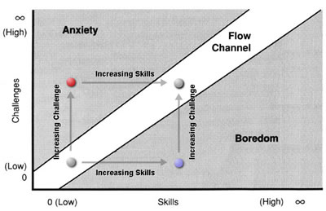
How do experts get to be experts ... without giving up?
Excitement, a desire to succeed.
Growth Mindset
Seek meaning & purpose
Flow, Mihaly Csikszentmihalyi, 1990 [ mee-HIGH CHEEK-sent-mee-HIGH-e ]
Notes:
Learning to ride a bike: first, there is the anxiety about falling off. If there are training wheels, it soon gets boring so the training wheels are raised just enough to feel some anxiety and heightened awareness, but no so much that you panic. We bounce back and forth between Anxiety and Boredom as we learn to stay upright, make a turn, get on by ourselves, go down hills, and experiment as to how hard we can brake.
How do experts get to be experts without giving up? They are good at staying in the Flow Channel. They can tolerate anxiety because of their confidence in learning new skills to meet the challenge. They fix their boredom by finding new challenges to apply their skills. Flow is a nice state to be in. Strain – being outside Flow – is not as nice but it is how we get better.
This is what your courses are doing to you each week. Instructors increase the challenge, you get anxious, increase your skills, submit your assignment, feel good for a few minutes, then tackle the next assignment when the cycle repeats. Instructors try to keep students out of the Boredom region but intentionally keep you in the Anxiety region. (Sorry.)
Good games – and academic programs – intend to keep you near a state of Flow. Each game level is hard enough to be interesting but without triggering too much anxiety. It allows your skill to increase, but before boredom ensues, you are promoted to the next level. (Candy Crush Saga periodically made levels so difficult to achieve that people would buy their way through the frustration. Or, you could accept boredom and wait 30 minutes for your lost lives to be replenished. It was brilliantly designed to generate ~$1M per day in revenue.)
Students find themselves in the anxiety region when they know the challenge is high but feel their skills are low. Students are in the boredom region when they overestimate their skills and don't appreciate the difficulty of the challenge. Or, students do not see the point of the challenge – or maybe it is indeed a pointless challenge – so there is no reason to make the effort of increasing one's skills. In other words, students are human.
(if you didn't care about succeeding, it would not cause anxiety or stress.)
————————————
Teachers can often find themselves in a high state of flow when in the classroom. A teacher is in a state of flow when a student asks for a desperately needed break. Students may be at the end of their listening endurance but the teacher is not yet tired of talking. Marking, on the other hand, is usually below teachers' flow channel in the boredom region. An old professor said he taught for free but was paid a lot of money to mark.
https://www.bakadesuyo.com/2013/04/interview-author-cal-newport-on-how-you-can-become-an-expert-and-why-you-should-not-follow-your-passion/
https://www.theatlantic.com/science/archive/2018/07/find-your-passion-is-terrible-advice/564932/

Slide 10
Henry Ford sums up the mindsets:
Whether you Think You Can or Think You Can’t,
you're right.
Notes:
Growth and Fixed mindsets, respectively.
Note the use of “think” instead of “know”. you can think but you cannot know for sure whether you are right or wrong.
Infinity goes both ways. (not impossible. "I'm possible." )
“There is nothing either good or bad, but thinking makes it so” William Shakespeare, Hamlet. Act II, Scene 2
I can't do it. - Ozan Varol | Personal Development – https://ozanvarol.com/i-cant-do-it/
If you think you can’t, you might have something similar to “math anxiety”.
Research shows we all learn at the same rate with deliberate practice during the learning process. This is consistent across all disciplines. Learning rates appear different because we all start from different levels of initial expertise. (e.g. people familiar with playing card games already have learned about 4 suits where each of 13 cards has a rank, and the concept of playing hands or tricks. It is not easier to learn Euchre than Bridge. It is shorter to learn Euchre than Bridge.) Meaning: it does not matter where you start from, we can all get there if we do the work. " Despite the availability of up-front verbal instruction, like lectures and readings, students demonstrate modest initial prepractice performance, at about 65% accuracy. Despite being in the same course, students’ initial performance varies substantially from about 55% correct for those in the lower half to 75% for those in the upper half. In contrast, and much to our surprise, we found students to be astonishingly similar in estimated learning rate…
The data used in this study was from students from elementary to college courses in math, science and language. Koedinger said that for all students, a growth mindset is important.
"No matter who you are, you can do it. You might have had fewer prior opportunities in your life, so it may be harder at first than it is for other people, but you will make just as much progress as anyone else as long as you stick to it," he said. " https://phys.org/news/2023-04-myth-fast-learner.html
Kenneth R. Koedinger et al, An astonishing regularity in student learning rate, Proceedings of the National Academy of Sciences (2023). DOI: https://www.pnas.org/doi/10.1073/pnas.2221311120
Finally…

Slide 11
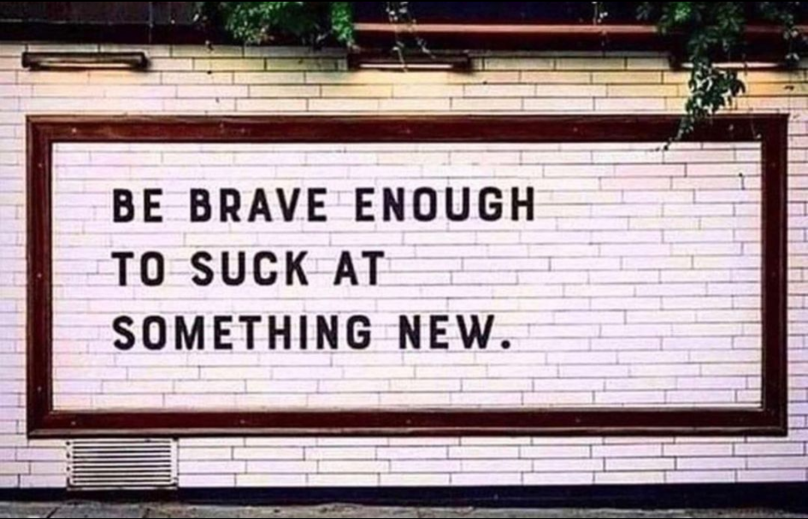
Notes:
we fear an unknown outcome more than we do a known bad one (https://www.psychologytoday.com/us/blog/happiness-in-world/201004/trying-new-things)
Sounds good…but what about tomorrow when the wheels come off?
Reframe stress as excitement. Studies show the physiological states are the same, it’s only how we choose to see them that is different.
It’s not anxiety; it’s a desire to succeed. (if you didn't care about succeeding, it would not cause anxiety or stress.) It’s not stress; it’s a challenge. Emotions are not destiny, they are stories. Rewrite them. See https://www.bakadesuyo.com/2020/12/emotionally-intelligent-2/
"Fear doesn’t control us by dominating our emotions. It controls us by quietly convincing us that our comfort is more important than happiness.
The only real risk is taking no risks. The only real failure is having no failures. The only real pain is the avoidance of pain." — Mark Manson https://markmanson.net/breakthrough/001-does-fear-control-you
Long-time reader Brandon says he has adopted a “fear of regret is higher than fear of failure” mindset recently, with tangible results:
“Being comfortable with being uncomfortable has caused immense professional development, caused me to leave relationships that limited my growth, and has inspired me to start a new company and do things I never would’ve been able to before.”
How to Get Over Perfectionism (markmanson.net) https://markmanson.net/perfectionism Your professor is to "blame" for your mark. You are responsible for the work.

Slide 12
More ideas follow…
You can be excellent without being perfect

Slide 13
There is a past version of yourself ridiculously proud of who you are today. – Rabbi Brian
Notes:
Every time we realize we made a mistake isn't necessarily also a time we must think there is something wrong with us. --- Rabbi Brian
Don’t try to be better than others, try to be better than you.
It’s simple, very simple. You don't need to be perfect. Just better than yesterday.
“The greatest danger for most of us is not that our aim is too high and we miss it, but that it is too low and we reach it.” ― Michelangelo
“Perfect is the enemy of good.” Allan Gurganus
“And now that you don’t have to be perfect, you can be good.” – John Steinbeck
"Everyone forgets that Icarus also flew." —— Jack Gilbert
You don’t inspire others by being perfect. You inspire them by how you deal with your imperfections. – Eric Barker at https://www.instagram.com/p/CEmCBpdgK_A/
What is the difference Between your experience of Existence And that of a Saint?
The Saint knows That the spiritual path Is a sublime chess game with God
And that the Beloved Has just made such a Fantastic Move
That the Saint is now continually Tripping over Joy And bursting out in Laughter And saying, “I Surrender!”
Whereas, my dear I am afraid you still think
You have a thousand serious moves.
― Hafiz
"To do the useful thing, to say the courageous thing, to contemplate the beautiful thing: that is enough for one man's life.“ ― T.S. Eliot

Slide 14
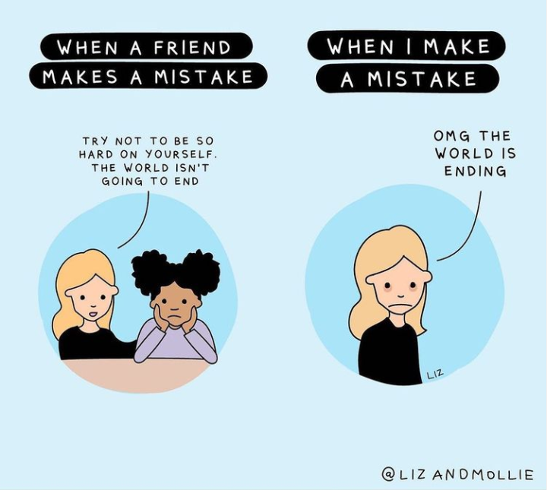
Do unto yourself as you do unto others.

Slide 15
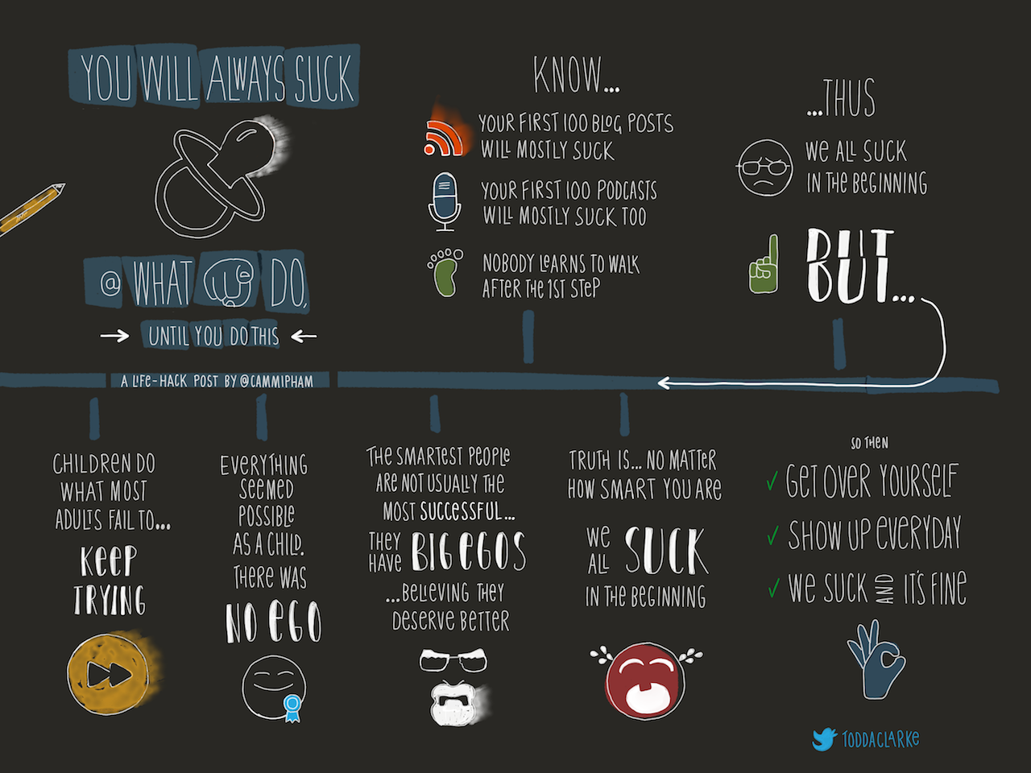
Notes:
http://www.cammipham.com/will-always-suck/
When your work is not coming together, it is not because you are not creative enough, intelligent enough, insightful enough, clever enough, disciplined enough. It is because you don’t understand enough…yet.
“What I cannot create, I do not understand.” -- Richard Feynman
Dr. Feynman's statement is deliberately…huh? It is the corollary he is leading us to: What I understand, I can recreate.
The quote is taken from his blackboard at the time of his death. Right underneath, it says, "Know how to solve every problem that has been solved." …because knowing how to solve a problem is better than knowing the solution.
For the photo and a good explanation of what Feynman considered 'understanding', see https://www.quora.com/What-did-Richard-Feynman-mean-when-he-said-What-I-cannot-create-I-do-not-understand

Slide 16
Working like a programmer
1. WHAT do programmers do?
2. HOW do programmers do it?
3. WHY do programmers do it?
Notes:
WHAT do programmers do? They write software to do clever things on hardware. And they spend a lot of time feeling wrong.
HOW do programmers do it? They have an SDLC process. They use IDEs and languages and development stacks. They go to Seneca.
WHY do programmers do it? … if you don't know why, find out why.
When Apple was just another computer company…
WHAT: Apple makes great computers; we make both the hardware and our unique operating system to ensure they work together well.
HOW: Apple computers are user-friendly, beautifully designed, and easy to use. Even the packaging is beautiful.
WHY: They're sleek and white so everyone can see you have an expensive Apple product.
Are you running out of memory or storage on your iPhone / iPad / Macbook? Easy fix: buy a new one; remember, we make great computers, and you should always have the latest and greatest one.
But Apple changed from being just another computer company:
1997 Think Different ad. https://youtu.be/vvmhFE5p0Z0
Why: With everything we do, we aim to challenge the status quo. We aim to think differently. How: Our products are user-friendly, beautifully designed, and easy to use.
What: We just happen to make great computers. Want to buy one?
This is not a new approach. “If you want to build a ship
don’t herd people together to collect wood WHAT
and don’t assign them tasks and work, HOW
but rather teach them to long for the
endless immensity of the sea.” WHY
― Antoine de Saint-Exupéry
What we do, How we do it, Why we do it. Start with Why (Simon Sinek, https://www.youtube.com/watch?v=IPYeCltXpxw )
Apple focuses on providing the best user experience and owns it completely.
Apple designs and develops own operating systems, hardware, application software, and services. Then, it integrates them seamlessly to build quality products that people will be proud to have while protecting user security and privacy.
See https://www.fastcompany.com/90458207/steve-jobss-real-talent-wasnt-design-it-was-seduction
1997 Apple Store (opens online)
1998 iMac 2000 changes licensing terms to make Mac-cloning cost-prohibitive.
candy-colored iMacs released in 1998 added a sensual dimension to what was also a powerful (for the time) machine: vibrant colors that provoked smiles, a curvaceous teardrop shape, and that round mouse (okay, we blew it with that one). The iMac was a delight to look at and to use, and people loved it. In the tech world, beauty became as important as speed and power.
2001 iTunes exclusively for Mac users until 2003. iTunes changed the way media was bought and consumed.
2001 iPod exclusively for Mac users until 2002. successful because it was user-friendly, beautifully designed, and easy to use. iTunes made it easy to get stuff to put on the iPod. The white iPod and especially its white earphones let everyone know that you thought differently. WHY was important enough to be obvious and advertised by those white wires hanging from your ears. Why else would a music player be so conspicuous?
It was easier to use (HOW) than other mp3 players which had been maturing on the market for 3 years already. iTunes made obtaining music easy, affordable, and legal. WHY and HOW trumped the WHAT of other technically better mp3 players which were harder to use both in terms of operation and the obtaining and formatting of music files for the player. How you obtained those files was suspect (e.g. Napster).
2003 iTunes Music Store changed media marketing and distribution for everyone not an Apple customer.
2005: Apple becomes reliably profitable and its market cap takes off. From near bankruptcy in the 1990s, to $5B in 2003, to $31B in 2005, to $200B in 2010, to $1T in 2018.
See also https://getpocket.com/explore/item/the-3-stages-of-failure-in-life-and-work-and-how-to-fix-them
which also addresses What, How, and Why.

Slide 17
Working like a programmer — start with why
3. WHY do we do it? Purpose.
2. HOW do we do it? Mastery.
1. WHAT do we do? Autonomy.
Notes:
Purpose, Mastery, and Autonomy – these are the trinity of work satisfaction and the key to loving what you do. They develop over time. These things feed and are fed by hope and optimism and a growth mindset. Interest and passion often follow from your increasing Mastery which enables your Purpose for which you create opportunity to gain your Autonomy.
Why do we do it? Purpose. We seek to understand people's problems and help them find a solution. How do we do it? Mastery. We use tools skillfully: SDLC, languages, frameworks, GitHub, development stacks, IDEs
What do we do? Autonomy. We get to make our own decisions (mostly) to control computers and do clever things with software.
Sometimes we are wrong in what we do. Software has bugs.
Sometimes we are wrong in how we do it. Another language, framework, or development stack may have been better suited to the job.
But we are never wrong about why we do it. (…so long as it is your own why and not someone else's)
Just because programmers are wrong most of the time doesn't mean it's a bad thing. feeling wrong means, we get to learn new things, experiment, and do something that has not been done before. That's a nice place to be when you feel wrong.
————————————————-
you start your own company–Autonomy–to exercise your Mastery to fulfill your Purpose. Then you phase yourself out of your company and establish the Bill and Melinda Gates Foundation to make the world a better place. Being one of the richest people on Earth makes Autonomy easy, but Mastery is no longer being the smartest guy in the room at Microsoft (a fixed mindset); it is a never-ending process of learning from others about where the problems and possibilities are, then pursuing the Purpose of finding solutions few others want to realize because those solutions would not be profitable or prestigious. (the growth mindset) e.g. Everyone wants their picture taken beside the new well. No one wants their picture taken beside the newly dug latrine even though the latrine – not the well – is the first step to clean water.
Autonomy, Mastery, and Purpose (Dan Pink on Motivation and scads of psych and social research)
https://www.bakadesuyo.com/2013/04/interview-author-cal-newport-on-how-you-can-become-an-expert-and-why-you-should-not-follow-your-passion/
https://www.theatlantic.com/science/archive/2018/07/find-your-passion-is-terrible-advice/564932/
https://www.cnbc.com/2019/02/20/simon-sinek-these-2-life-changing-books-will-train-your-brain-for-success.html

Slide 18
Make feeling wrong worthwhile… fill in the blanks
I will do this thing
in order to complete this work, achieve this goal
so that it will make this difference
Establish your Autonomy
Develop your Mastery
Fulfill your Purpose
Notes:
Why: what's your purpose? What's your cause? What's your belief? Fill-in-the-blank to discover what to do with your life…
If you are not sure about a grand purpose, ask what you want. Not the stuff you want, the world you want. Mankind went from the first powered flight in 1902 travelling 260 meters to flying 3 million meters across the Atlantic Ocean 16 years later, and to the moon 50 years after that, 384 million meters away. "We wanted to go to the moon, so we went there." — Muhammad Yunus, Nobel Peace Prize Laureate, 2006. In less than one normal lifespan, people went from here to there solely because they wanted to. So if you are not sure of your purpose, what do you want?
I will do <– this thing (or series of things) in order to ____________________ <– make your contribution, do your work, achieve your goal
so that _____________________ <– the impact of your contribution
To help advance science forward so that there is less suffering in the world
To work on new technology so that people become more connected (not addicted to the new technology).
So, go ahead, fill in the blanks.
-----------------------------------------
https://www.cnbc.com/2019/02/20/simon-sinek-these-2-life-changing-books-will-train-your-brain-for-success.html
The purpose of life is to discover your gift. The work of life is to develop it. The meaning of life is to give your gift away. —David Viscott, 1993
To laugh often and much; to win the respect of the intelligent people and the affection of children; to earn the appreciation of honest critics and endure the betrayal of false friends; to appreciate beauty; to find the beauty in others; to leave the world a bit better whether by a healthy child, a garden patch, or a redeemed social condition; to know that one life has breathed easier because you lived here. This is to have succeeded. ― Ralph Waldo Emerson
The world will ask who you are, and if you don’t know, the world will tell you. ― Carl Jung

